Slide 1

.NET Class
Suvash Shah Thakuri

Slide 2
Scope Of Variables and Methods
Public
Anywhere in or outside of class as well as project
Private
Only in the class, block where defined
Protected
Can be used in the class where defined and from other inherited class as well
Internal
Only in defined class and project. When it is referenced by other project, it will not be visible to new project.

Slide 3
Constants and Literals
Fixed valued variable that are not altered during program execution
Constants value can not be modified after declaration
Const <data_type> <constant_name> = value;

Slide 4
Data Types
Value Types
Value type variables can be assigned a value directly. They are derived from the class System.ValueType.
Ex. int, char, float etc
Memory is allocated for storing value

Slide 5
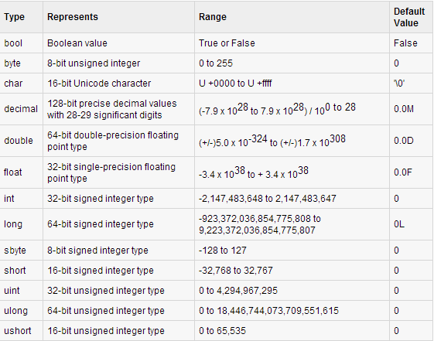

Slide 6
Data Types
Reference Types
The reference types do not contain the actual data stored in a variable, but they contain a reference to the variables.
They refer to a memory location
Eg. object, dynamic and string.
dynamic d = 20;
String str = “your value”;

Slide 7
Data Types
Pointer types
Pointer type variables store the memory address of another type
type* identifier;
char* cptr;
int* iptr;

Slide 8
References
http://www.tutorialspoint.com/csharp/index.htm

